Slide 1
Multi-stage Gene Expression Profile Analysis Reveals Genes Related to Abnormal Accumulation of Sphingolipid
Ph.D.-Complex Biosystem Program
PSI-Plant Science&Inovation Center
Fan Huang

Slide 2
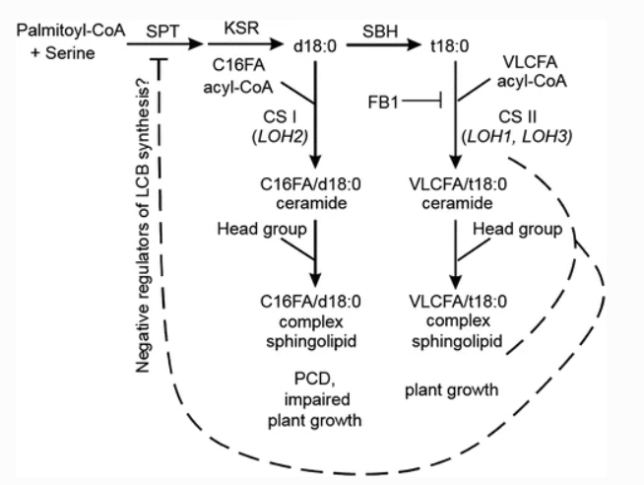

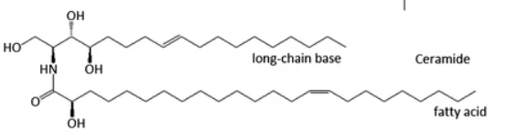

Sphingolipid and its synthesis pathway
AtLOH2, the gene which is responsible to short chain fatty acid sphingolipid synthesis.
There are two types of sphingolipid in plants, short chain fatty acid sphingolipid (Minor) and very long chain fatty acid sphingolipid (Major)

Slide 3
Question:
Previous study already shown that the overexpression of AtLOH2 will resulted the abnormal accumulation of short chain fatty acid sphingolipid, which will then lead to the death of Arabidopsis thaliana(Kyle et al., 2015).
So what is happening during the plant during the whole period?

Slide 4
Work overview:
The AtLOH2 gene was induced following 21 days of growth in soil in Arabidopsis plants. Whole-genome gene expression levels were assessed through RNAseq at 0, 1, 3, and 7 days post-induction.
And my project is to cluster these genes and identify the possible genes may related to the abnormal accumulation of sphingolipid.

Slide 5
Aims:
Aim 1:
Use R packages to perform clustering of these genes based on their expression profiles.
Aim 2:
Use R packages to generate distinct clusters and assess which clusters encompass known genes associated with sphingolipid synthesis. Additionally, endeavor to identify novel genes linked to the abnormal accumulation of sphingolipids.

